Slide 1
Verilog HDL语言
主讲：卢 萍
华中科技大学计算机科学与技术学院

Slide 2
Verilog HDL语言
Verilog程序设计方法

Slide 3
Module Styles
Modules can be specified different ways
  Structural – connect primitives and modules
  Dataflow– use assign continuous assignments
    assign <LHS net> = <RHS expression>;
  Behavioral – use initial and always blocks
A single module can use more than one method!
What are the differences?

Slide 4
Structural Example
module majority (major, V1, V2, V3) ; // 三变量的多数表决电路
多数赞同时，输出高电平
output major ;
input V1, V2, V3 ;
wire N1, N2, N3;
and A0 (N1, V1, V2),
A1 (N2, V2, V3),
A2 (N3, V3, V1);
or Or0 (major, N1, N2, N3);
endmodule
V1
N1
A0
V2
V2
A1
N2
Or0
major
V3
V3
A2
N3
V1
majority

Slide 5
RTL/Dataflow Example
（RTL：register transfer level）
module majority (major, V1, V2, V3) ;
output major ;
input V1, V2, V3 ;
assign major = V1 & V2
| V2 & V3
| V1 & V3;
endmodule
majority
V1
V2
major
V3

Slide 6
Behavioral Example
module majority (major, V1, V2, V3) ;
output reg major ;
input V1, V2, V3 ;
always @(V1, V2, V3)
begin
if (V1 && V2 || V2 && V3
|| V1 && V3) major = 1;
else major = 0;
end
endmodule
majority
V1
V2
major
V3

Slide 7
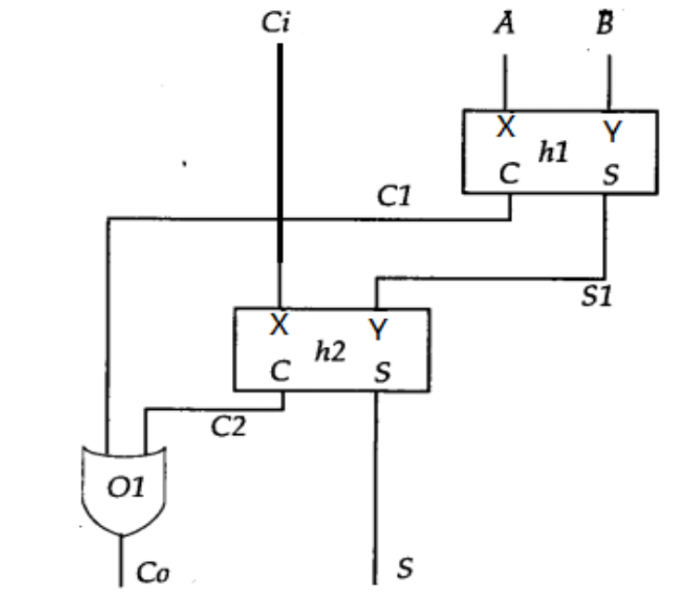
Full Adder: Structural
module half_add (X, Y, S, C);
input X, Y ;
output S, C ;
xor SUM (S, X, Y);
and CARRY (C, X, Y);
endmodule
使用两个半加器模块构造全加器
module full_add ( input A, B, CI, output S, CO) ;
wire S1, C1, C2;
half_add h1 (A, B, S1, C1),
h2 (S1, CI, S, C2); //两个 half_add半加器模块实例语句
or CARRY (CO, C2, C1); // or门实例语句
endmodule

Slide 8
Full Adder: RTL/Dataflow
module fa_rtl (A, B, CI, S, CO) ;
input A, B, CI ;
output S, CO ;
// use continuous assignments
assign S = A ^ B ^ CI;
assign C0 = (A & B) | (A & CI) | (B & CI);
endmodule
Data flow Verilog is
often very concise
and still easy to read
Works great for most
boolean and even
datapath descriptions
Slide taken direct from Eric Hoffman

Slide 9
Full Adder: Behavioral
只要有事件发生（列表中任何 信号有变化），就执行begin...end 的语句 (for simulation)
---- 实际上，列表中信号的改变影响输出
module fa_bhv (A, B, CI, S, CO) ;
input A, B, CI;
output S, CO;
reg S, CO; // 只有reg型能够在 always 语句中被赋值
always@(A or B or CI) // 由事件控制的always语句
begin
S = A ^ B ^ CI; // 过程性赋值语句,，必须在 always 过程块中
CO = (A & B) | (A & CI) | (B & CI);
end
endmodule

Slide 10
Full Adder: Behavioral
IN SIMULATION
  When A, B, or C change, S and CO are recalculated
IN REALITY
  Combinational logic – no “waiting” for the trigger
  Constantly computing - think transistors and gates!
  Same hardware created for all three types of verilog
Slide taken direct from Prof. Schulte
A
always@(A or B or CI)
begin
S = A ^ B ^ CI;
CO = (A & B) | (A & CI) | (B & CI);
end
S
B
CI
majority
CO
fa_bhv

Slide 11
Structural Basics: Primitives（原语）
Build design up from the gate/flip-flop/latch level
  Structural verilog is a netlist of blocks and connectivity
Verilog provides a set of gate primitives
  and, nand, or, nor, xor, xnor, not, buf, bufif1, etc.
  Combinational building blocks for structural design
  Known “behavior”
  Cannot access “inside” description
Can also model at the transistor level
  Most people don’t, we won’t

Slide 12
原语
不用声明，直接实例化
输出端口在前，输入端口在后
实例名和时延可选 (时延稍后讨论)
and N25 (Z, A, B, C); // N25是实例名
and #10 (Z, A, B, X),
(X, C, D, E); // delay specified, 2 gates
and #10 N30 (Z, A, B); // name and delay specified

Slide 13
Syntax For Structural Verilog
First declare the interface to the module
  Module keyword, module name
  Port names/types/sizes
Next, declare any internal wires using “wire”
  wire [3:0] partialsum;
Then instantiate the primitives/submodules
  Indicate which signal is on which port
ModelSim Example with ring oscillator

Slide 14
Hierarchy
Any Verilog design you do will be a module
This includes testbenches!
Interface (“black box” representation)
  Module name, ports
Definition
  Describe functionality of the block
Instantiation
  Use the module inside another module

Slide 15
层次结构
由较小的部件构建一个模块
  原语
  其它模块
电路设计方法: top-down
  系统分为几个模块，每个模块再分为几个子模块，...，直至易于实现。
验证: bottom-up
Add_full
Add_half
Add_half
or
xor
and
xor
and
全加器的层次结构

Slide 16
Add_half Module
Add_half
xor
and
module half_add (C,S,X, Y );
output C, S;
input X, Y ;
xor SUM (S, X, Y);
and CARRY (C, X, Y);
endmodule

Slide 17
Add_full Module
Add_full
Add_half
Add_half
or
module Add_full(Co,S, A, B, Ci) ;
output Co,S;
input A, B, Ci;
wire S1, C1, C2;
Add_half h1( .C(C1), .S(S1), .X(A), .Y(B)); /* 端口名称关联 */
Add_half h2( .C(C2), .S(S), .X(Ci), .Y(S1));
or carry_bit(Co, C1, C2); /* 端口位置关联 */
endmodule

Slide 18
Can Mix Styles In Hierarchy!
module Add_half_bhv(c_out, sum, a, b);
output reg sum, c_out;
input a, b;
always @(a, b) begin
sum = a ^ b;
c_out = a & b;
end
endmodule
module Add_full_mix(c_out, sum, a, b, c_in) ;
output sum, c_out;
input a, b, c_in;
wire w1, w2, w3;
Add_half_bhv AH1(.sum(w1), .c_out(w2),
.a(a), .b(b));
Add_half_bhv AH2(.sum(sum), .c_out(w3),
.a(c_in), .b(w1));
assign c_out = w2 | w3;
endmodule

Slide 19
Hierarchy And Scope
Parent cannot access “internal” signals of child
If you need a signal, must make a port!
Example:
Detecting overflow
Overflow =
cout XOR cout6
Must output
overflow or cout6!
module add8bit(cout, sum, a, b);
output [7:0] sum;
output cout;
input [7:0] a, b;
wire cout0, cout1,… cout6;
FA A0(cout0, sum[0], a[0], b[0], 1’b0);
FA A1(cout1, sum[1], a[1], b[1], cout0);
…
FA A7(cout, sum[7], a[7], b[7], cout6);
endmodule

Slide 20
层次化 与 源文件
多个module是放在同一个文件还是分开放？
可以放在同一个文件中
  模块次序自由
  适合于小设计
  不太适合模块重用（剪切和粘贴）
可以将模块分解成多个文件
  良好习惯：每个文件只包含一个module
  有助于组织模块
  便于找到一个模块
  有利于模块重用（将文件添加到项目中）

Slide 21
Structural Verilog: Connections
Positional or Connect by reference
  Can be okay in some situations
    Designs with very few ports
    Interchangeable input ports (and/or/xor gate inputs)
  Gets confusing for large #s of ports
module dec_2_4_en (A, E_n, D);
input [1:0] A;
input E_n;
output [3:0] D;
.
.
.
wire [1:0] X;
wire W_n;
wire [3:0] word;
// instantiate decoder
dec_2_4_en DX (X, W_n, word);
Partial code instatiating decoder

Slide 22
Structural Verilog: Connections
Explicit or Connect by name method
  Helps avoid “misconnections”
  Don’t have to remember port order
  Can be easier to read
  .<port name>(<signal name>)
wire [1:0] X;
wire W_n;
wire [3:0] word;
// instantiate decoder
dec_2_4_en DX (.A(X), .E_n(W_n), .D(word));
module dec_2_4_en (A, E_n, D);
input [1:0] A;
input E_n;
output [3:0] D;
  .
  .
  .
Partial code instatiating decoder

Slide 23
Empty Port Connections
Example: module dec_2_4_en(A, E_n, D);
  dec_2_4_en DX (X[1:0], , word); // E_n is high impedence (z)
  dec_2_4_en DX (X[1:0], W_n , ); // Outputs D[3:0] unused.
General rules
  Empty input ports => high impedance state (z)
  Empty output ports => output not used
Specify all input ports anyway!
  Z as an input is very bad…why?
Helps if no connection to output port name but leave empty:
  dec_2_4_en DX(.A(X[3:2]), .E_n(W_n), .D( ));

Slide 24
Dataflow Verilog
The continuous assign statement
  It is the main construct of Dataflow Verilog
  It is deceptively powerful & useful
Generic form:
assign [drive_strength] [delay] list_of_net_assignments;
Where:
list_of_net_assignment ::= net_assignment [{,net_assignment}]
& Where:
Net_assignment ::= net_lvalue = expression
OK…that means just about nothing to me…how about some examples?

Slide 25
Continuous Assign Examples
Simplest form:
  // out is a net, a & b are also nets
  assign out = a & b; // and gate functionality
Using vectors
  wire [15:0] result, src1, src2; // 3 16-bit wide vectors
  assign result = src1 ^ src2; // 16-bit wide XOR
Can you implement a 32-bit adder in a single line?
  wire [31:0] sum, src1, src2; // 3 32-bit wide vectors
  assign {c_out,sum} = src1 + src2 + c_in; // wow!

Slide 26
Back to the Continuous Assign
More basic generic form:
assign <LHS> = <RHS expression>;
If RHS（right hand side） result changes, LHS is updated with new value
  Constantly operating (“continuous”)
  It’s hardware!
  RHS can use operators (i.e. +,-,&,|,^,~,>>,…)
src1[31:0]
src2[31:0]
c_in
➔
assign {c_out,sum} = src1 + src2 + c_in;
c_out
sum[31:0]

Slide 27
Lets Kick up the Horse Power
You thought a 32-bit adder in one line was powerful. Lets try a 32-bit MAC…
Design a multiply-accumulate (MAC) unit（乘法累加器） that computes
Z[31:0] = A[15:0]*B[15:0] + C[31:0]
It sets overflow to one, if the result cannot be represented using 32 bits.
module mac(output [31:0] Z, output overflow,
input [15:0] A, B, input [31:0] C);

Slide 28

Lets Kick up the Horse Power
module mac(output [31:0] Z, output overflow,
input [15:0] A, B, input [31:0] C);
assign {overflow, Z} = A*B + C;
endmodule
I am a brilliant genius. I am a HDL coder extraordinaire. I created a 32-bit MAC, and I did it in a single line.
assign {overflow, Z} = A*B + C;
Oh my god, I’ve created a monster
Synopsys

Slide 29
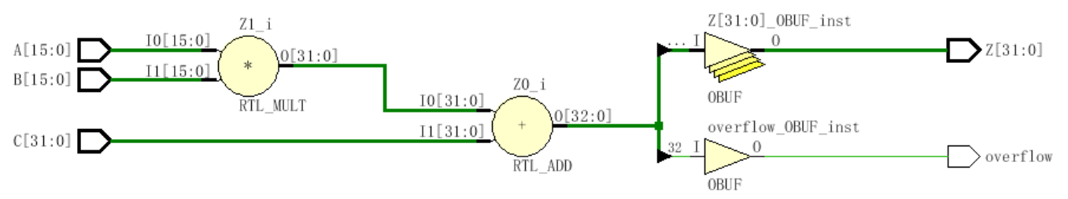
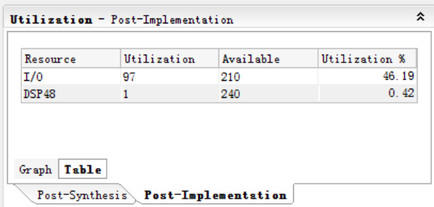
module mac(output [31:0] Z, output overflow,
input [15:0] A, B, input [31:0] C);
assign {overflow, Z} = A*B + C;
endmodule

Slide 30
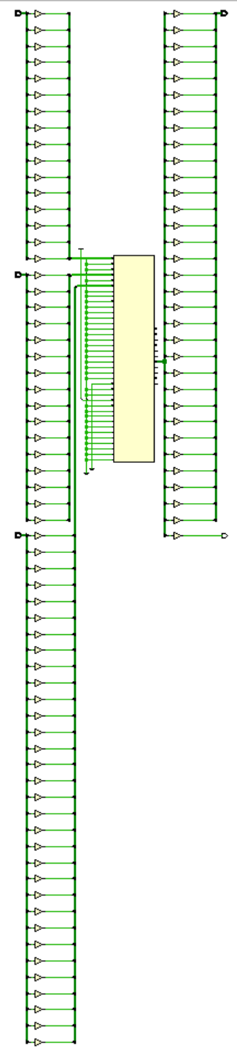

Slide 31
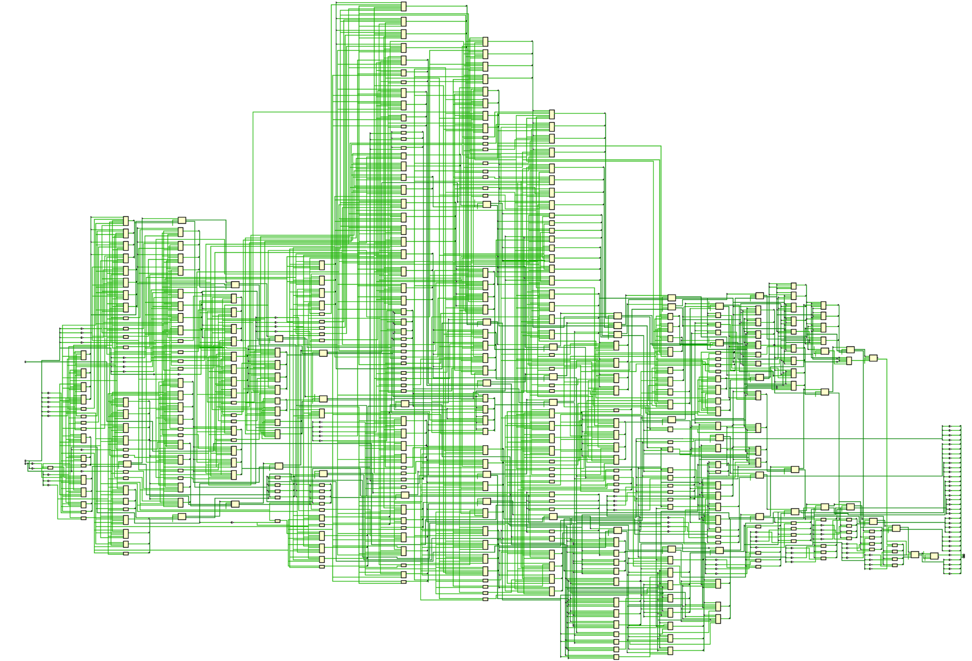

Slide 32
A Few Other Possibilities
The implicit assign
  Goes in the wire declaration
  wire [3:0] sum = a + b;
  Can be a useful shortcut to make code succinct, but doesn’t allow fancy LHS combos
  assign {cout, sum} = a + b + cin;
  Personal choice
    You are welcome to use it when appropriate (I never do!)

Slide 33
Behavioral Verilog
行为建模的主要机制：initial and always
  所有其他的行为语句包含在这两个语句中
  initial and always 块不能嵌套
  左边变量必须是 reg 类型
initial 语句从0时刻开始执行且只执行一次
  如果有多个initial块，它们都从0时刻开始并行独立执行，独立完成执行.
如果在initial语句中有多条行为语句，那么需用begin/end 组合在一起。
initial常用于测试文件

Slide 34
More on initial statements
Initial statement very useful for testbenches
Initial statements don’t synthesize
Don’t use them in DUT（DUT：device under test） Verilog (stuff you intend to synthesize)

Slide 35
initial Blocks
`timescale 1 ns / 100 fs
module full_adder_tb;
reg [3:0] stim;
wire s, c;
add_full DUT (c, s, stim[2], stim[1], stim[0]); // instantiate DUT
// monitor statement is special - only needs to be made once,
initial $monitor(“%t: s=%b c=%b stim=%b”, $time, s, c, stim[2:0]);
// tell our simulation when to stop
initial #50 $stop;
initial begin // stimulus generation
for (stim = 4’h0; stim < 4’h8; stim = stim + 1) begin
#5;
end
end
endmodule
all initial blocks start at time 0
multi-statement block enclosed by begin and end

Slide 36
Another initial Statement Example
module stim()
reg m,a,b,x,y;
initial
m = 1’b0;
initial begin
#5 a = 1’b1;
#25 b = 1’b1;
end
initial begin
#10 x = 1’b1;
#25 y = 1’b1;
end
initial
#50 $finish;
endmodule
Time
Event
0
m = 1’b0
5
a = 1’b1
Modelsim
10
x = 1’b1
30
b = 1’b1
35
y = 1’b1
50
$finish
What events at what times will a verilog simulator produce?

Slide 37
always statements
always语句重复执行
  从0时刻开始不断循环执行；
  可以使用触发/敏感事件列表来控制操作; @(a or b or c)
  没有触发事件，将在0时刻无限循环执行。
module clock_gen (output reg clock);
initial
clock = 1’b0; // must initialize in initial block
always // no trigger list for this always
#10 clock = ~clock; // 带有时序控制
//产生周期为20时间单位的波形
endmodule

Slide 38
always vs initial
reg [7:0] v1, v2, v3, v4;
initial begin
v1 = 1;
#2 v2 = v1 + 1;
v3 = v2 + 1;
#2 v4 = v3 + 1;
v1 = v4 + 1;
#2 v2 = v1 + 1;
v3 = v2 + 1;
end
reg [7:0] v1, v2, v3, v4;
always begin
v1 = 1;
#2 v2 = v1 + 1;
v3 = v2 + 1;
#2 v4 = v3 + 1;
v1 = v4 + 1;
#2 v2 = v1 + 1;
v3 = v2 + 1;
end
What values does each block produce?
  Lets take our best guess
  Then lets try it in a simulator

Slide 39
always的事件控制方式
always是基于事件执行，有两种类型的事件控制方式
  边沿触发事件控制:用来描述时序逻辑电路
  电平敏感事件控制:用来描述组合逻辑电路
always @(posedge clk) // clk从低电平->高（正沿）
cur_state =next_state; // 就执行赋值语句
always @(negedge reset) // reset从高->低（负沿）
count =0; // 就执行赋值语句
事件之间能够相或，表示有任何事件发生
always @ (posedge clear or negedge reset )
Q=0;

Slide 40
电平敏感信号列表
只要列表内有信号发生电平变化，就执行该always结构中的内容。
Original way to specify trigger list
always @ (X1 or X2 or X3)
In Verilog 2001 can use , instead of or
always @ (X1, X2, X3)
Verilog 2001 also has * for combinational only
always @ (*) //“*”代表所有输入信号，可防止遗漏
Some mixed simulation tools in use today still do not support Verilog 2001.
不可以同时包括电平敏感事件和边沿敏感事件，也不可以同时包括同一个信号的上升沿和下降沿.

Slide 41
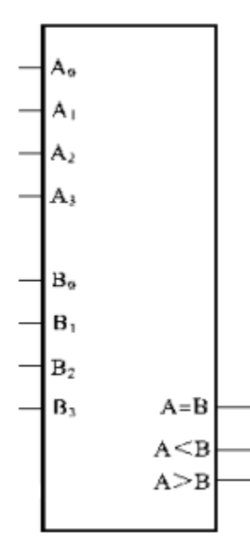
Example: 比较器
module compare_4bit_behave(output reg A_lt_B, A_gt_B, A_eq_B,
input [3:0] A, B);
always@( ) begin
end
endmodule
A or B
if ( A > B )
{ A_lt_B, A_gt_B, A_eq_B } = 3'b010;
else if ( A == B)
{ A_lt_B, A_gt_B, A_eq_B } = 3'b001;
else
{ A_lt_B, A_gt_B, A_eq_B } = 3'b100;
Flush out this template with sensitivity list and implementation
Hint: a if…else if…else statement is best for implementation

Slide 42
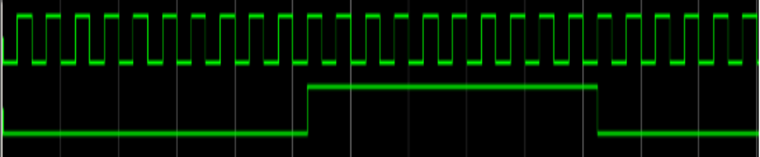
Example: 分频器
分频：将信号的频率降低为原来的1/N，就叫N分频。
分频器：实现分频的电路。
分频的实现：通过计数实现分频，当计数器从0计数到(N/2-1)时，输出时钟翻转，计数器清零
20分频

Slide 43
Example: 分频器
module divider(input clk, output clk_N);
reg [31:0] count;
always @( ) begin
end
endmodule
parameter N=20; // 参数说明，默认值20
//带参数值的模块引用
divider #(100) (clk100M,clk1M);
or
divider #(100) D1(clk100M,clk1M);
//或者在调用divider的上层模块中用//defparam来改写参数值
defparam D1.N=100;
divider D1(clk100M,clk1M);
posedge clk
if (count == (N>>1)-1 ) begin
count <= 32'b0;
clk_N <= ~clk_N;
end
else
count <= count + 1;

Slide 44
if-else 条件语句
case 语句
for循环语句
if (条件表达式) 块语句1
else if (条件表达式2) 块语句2
……
else if (条件表达式n) 块语句n
else 块语句n+1
case (敏感表达式)
值1： 块语句1
值2： 块语句2
……
值n： 块语句n
default：块语句n+1
endcase
for (表达式1；表达式2；表达式3）块语句

Slide 45
if…else if…else statement
General forms…
If (condition)
begin
<statement1>;
<statement2>;
end
else
begin
<statement3>;
<statement4>;
end
If (condition)
begin
<statement1>;
<statement2>;
end
else if (condition2)
begin
<statement3>;
<statement4>;
end
else
begin
<statement5>;
<statement6>;
end
If (condition) begin
<statement1>;
<statement2>;
end
Of course the compound statements formed with begin/end are optional.
Multiple else if’s can be strung along indefinitely

Slide 46
How does and if…else if…else statement synthesize?
  Does not conditionally “execute” block of “code”
  Does not conditionally create hardware!
  It makes a multiplexer or selecting logic
  Generally:
    Hardware for both paths is created
    Both paths “compute” simultaneously
    The result is selected depending on the condition
if (func_add)
alu = a + b;
else if (func_and)
alu = a & b;
else
alu = 8’h00;
+
alu
a[7:0]
1
&
0
8
1
b[7:0]
8’h00
0
8
func_and
func_add

Slide 47
if statement synthesis (continued)
if (a)
func = c & d;
else if (b)
func = c | d;
c
d
1
d
0
q
func
How does this
synthesize?
en
a
b
Latch??
What you ask for is what you get!
func is of type register. When neither a or b are asserted it didn’t not get a new value.
That means it must have remained the value it was before.
That implies memory…i.e. a latch!
if 要加上else，以防止锁存器的发生
语句不完整即有某些情况的输入对输出无任何影响，根据锁存器的特征，反映到硬件电路即会产生锁存器。

Slide 48
More on if statements…
Watch the sensitivity lists…what is missing in this example?
always @(a, b) begin
temp = a – b;
if ((temp < 8’b0) && abs)
out = -temp;
else out = temp;
end
注意敏感信号的完备性：
必须将所有的输入信号和条件判断信号都列在信号列表中。
always @ (posedge clk) begin
if (reset) q <= 0;
else if (set) q <= 1;
else q <= data;
end
//带同步清0、同步置1的D触发器
What is being coded here?
Is it synchrounous or asynch?
Does the reset or the set have
higher priority?

Slide 49
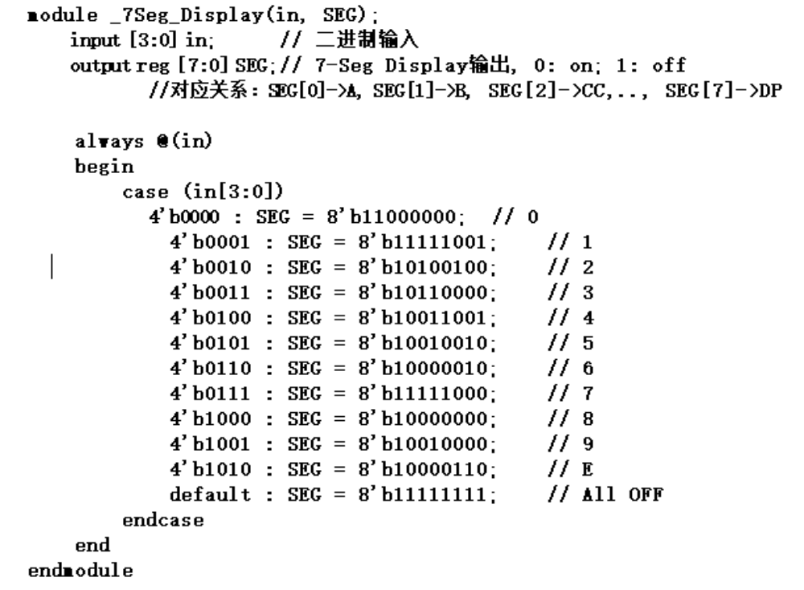
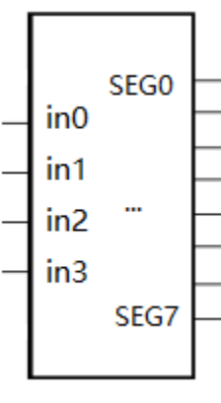
Example: 7段数码管的显示译码器
h g f e d c b a
显示0：1 1 0 0 0 0 0 0
a
f
b
g
e
c
d
h

Slide 50
case Statements
Verilog 有3种形式的cese语句:
  case, casex, and casez
case表达式按顺序与各分支项值按位匹配
  两者位宽相同!
case：是一种全等比较
  Can detect x and z ! (good for testbenches)
casez
  比较双方有一方的某些位的值是z，那么这些位的比较就不予考虑，而只关注其他位的比较结果
casex
  比较双方有一方的某些位的值是x和z，就不予考虑
？可用来代替z，表示无关位

Slide 51
Case statement (general form)
case (expression)
alternative1 : statement1; // any of these statements could
alternative2 : statement2; // be a compound statement using
alternative3 : statement3; // begin/end
default : statement4 // always use default for synth stuff
endcase
parameter AND = 2’b00;
parameter OR = 2’b01;
parameter XOR = 2’b10;
case (alu_op)
AND : alu = src1 & src2;
OR : alu = src1 | src2;
XOR : alu = src1 ^ src2;
default : alu = src1 + src2;
endcase
Why always have a default?
Same reason as always having an else with an if statement.
All cases are specified, therefore no unintended latches.
Slide taken direct from Eric Hoffman

Slide 52
Using case To Detect x And z
Only use this functionality in a testbench!
Example taken from Verilog-2001 standard:
case (sig)
1’bz: $display(“Signal is floating.”);
1’bx: $display(“Signal is unknown.”);
default: $display(“Signal is %b.”, sig);
endcase
Slide taken direct from Eric Hoffman

Slide 53
casex Statement
Uses x, z, and ? as single-bit wildcards in case item and expression
Uses first match encountered
always @ (code) begin
casex (code) // case expression
2’b0?: control = 8’b00100110; // case item1
2’b10: control = 8’b11000010; // case item 2 2’b11: control = 8’b00111101; // case item 3
endcase
end
What is the output for code = 2’b01 ?
What is the output for code = 2’b1x ?
Slide taken direct from Eric Hoffman

Slide 54
casez Statement
Uses z, and ? as single-bit wildcards in case item and expression
always @ (code) begin
casez (code)
2’b0?: control = 8’b00100110; // item 1
2’bz1: control = 8’b11000010; // item 2 default: control = 8b’xxxxxxxx; // item 3
endcase
end
What is the output for code = 2b’01?
What is the output for code = 2b’zz?
Slide taken direct from Eric Hoffman

Slide 55
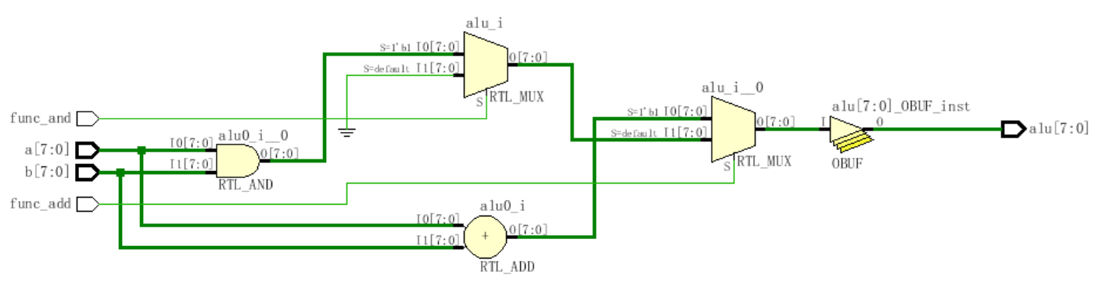
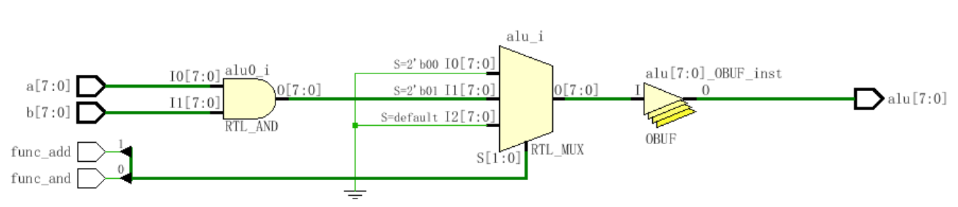
if (func_add)
alu = a + b;
else if (func_and)
alu = a & b;
else
alu = 8’h00;
case({func_add, func_and})
2'b00: alu = 8'h00;
2'b01: alu = a & b;
2'b1x: alu = a + b;
default: alu = 8'h00;
endcase
case的index列表里的x和z，都被综合工具认为是不可达状态,被去掉了。

Slide 56
Loops in Verilog
We already saw the for loop:
reg [15:0] rf[0:15]; // memory structure for modeling register file
reg [5:0] w_addr; // address to write to
for (w_addr=0; w_addr<16; w_addr=w_addr+1)
rf[w_addr[3:0]] = 16’h0000; // initialize register file memory
There are 3 other loops available:
  While loops
  Repeat loop
  Forever loop

Slide 57
while loops
Executes until boolean condition is not true
  If boolean expression false from beginning it will never execute loop
reg [15:0] flag;
reg [4:0] index;
initial begin // 找非0标志位
index=0;
found=1’b0;
while ((index<16) && (!found)) begin
if (flag[index]) found = 1’b1;
else index = index + 1;
end
if (!found) $display(“non-zero flag bit not found!”);
else $display(“non-zero flag bit found in position %d”,index);
end
Handy for cases where loop termination is a more complex function.
Like a search

Slide 58
repeat Loop
执行指定得循环次数
  Repeat的循环次数可以是一个变量，但
    其值在开始循环时得到计算，从而得以事先确定循环次数
    如果其值在循环执行期间发生更改，也不会更改迭代次数
在testbench，常与 @(posedge clk) 事件控制一起使用，用来等待固定数量的时钟。
initial begin
inc_DAC = 1’b1; // 等待clk的4095个正沿
repeat(4095) @(posedge clk); // bring DAC right up to point of rollover
inc_DAC = 1’b0;
inc_smpl = 1’b1;
repeat(7)@(posedge clk); // bring sample count up to 7
inc_smpl = 1’b0;
end

Slide 59
forever loops
无限循环。常用于产生周期性的波形，用来作为仿真测试信号。它与always的不同之处是不能独立在程序中，必须写在initial块中
Only a $stop, $finish or a specific disable can end a forever loop.
initial begin
clk = 0;
forever //每隔10个时间单位clk反相一次
#10 clk = ~ clk;
end
Clock generator is by far the most
common use of a forever loop

Slide 60
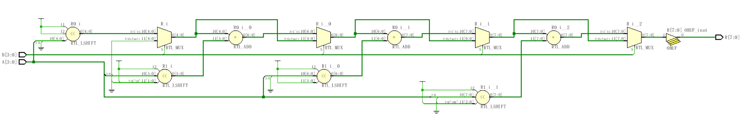
// 4b乘法器，R=A*B
module mult4b(output reg [7:0] R, input [3:0] A, input [3:0] B);
endmodule
integer i;
always @(A, B) begin
R = 0;
for(i=0; i<=3; i=i+1)
if(B[i]) R = R + (A<<i);
end
A： 1101
B： 1011
* ------------------------------
1101
1101
1101
+ ----------------------------
10001111
HDL里的for是并行展开，代码看似简洁，电路规模扩大了n倍。

Slide 61
赋值语句
阻塞型过程赋值：=
  前一条语句没有完成赋值过程之前，后面的语句不能被执行
非阻塞型过程赋值：<＝
  一条非阻塞赋值语句的执行，不会影响块中其它语句的执行
连续赋值语句
  只要输入端操作数的值发生变化，该语句就重新计算并刷新赋值结果。用关键词assign来区分。
  assign [<延时控制>] <线网变量>＝<表达式>；
基本形式：<寄存器变量>＝<表达式>；
外部模式：<定时控制> <寄存器变量>＝<表达式>；//定时满足，RHS被计算和赋值
内部模式：<寄存器变量>＝ <定时控制> <表达式>；//计算RHS，定时满足后再赋值
定时控制分为两类：延时控制 #delay
事件控制 @(事件控制敏感表）

Slide 62
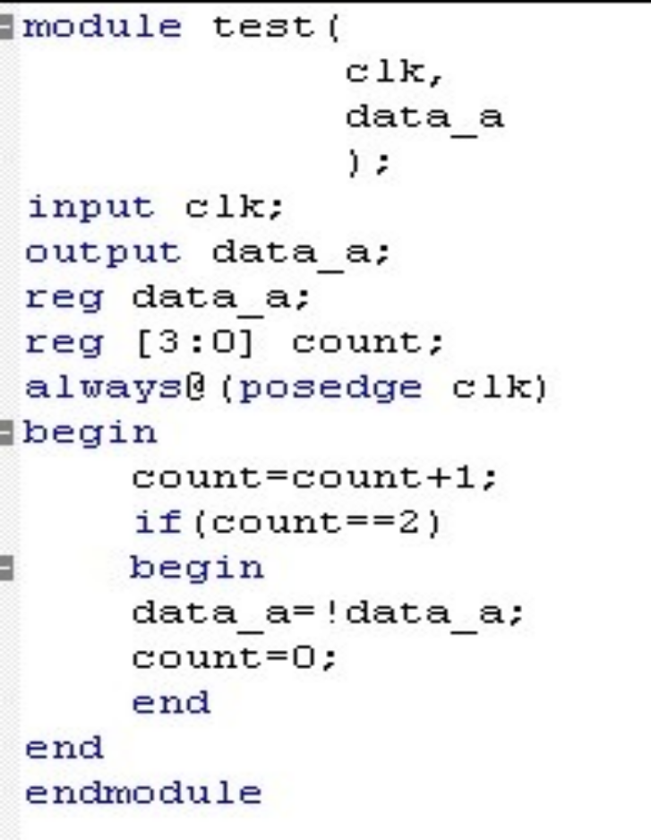
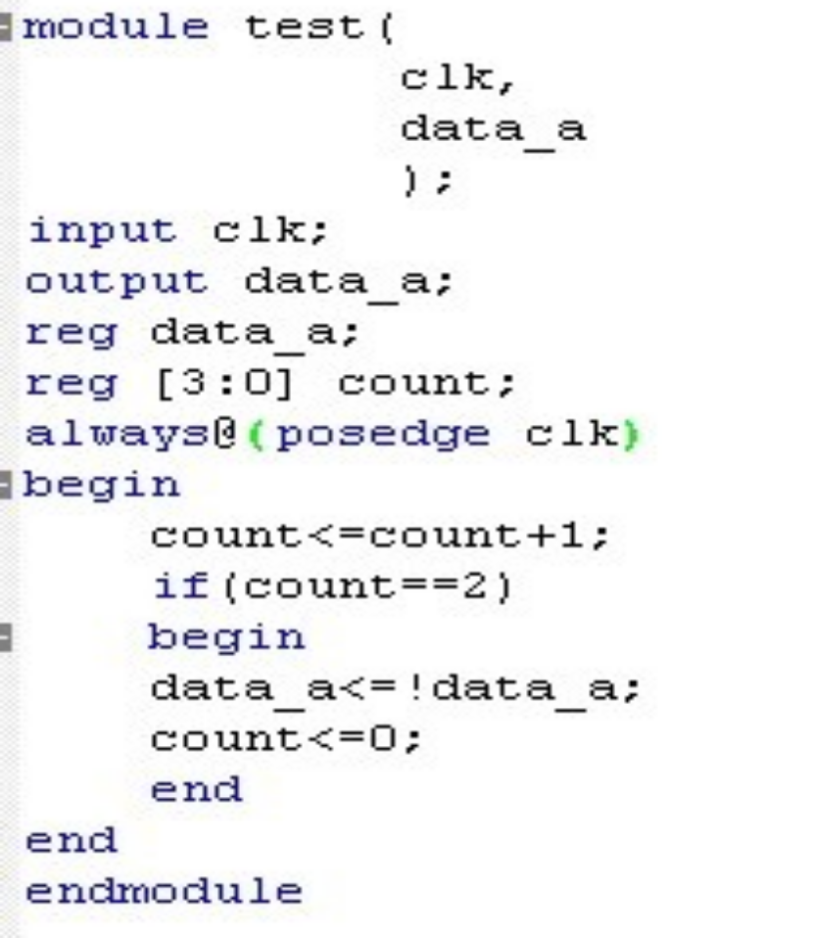
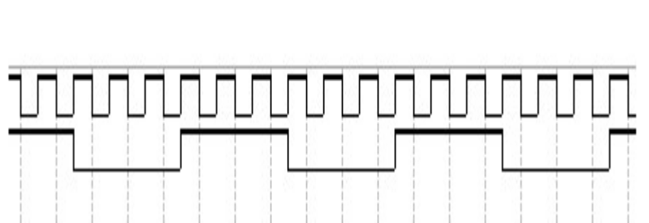
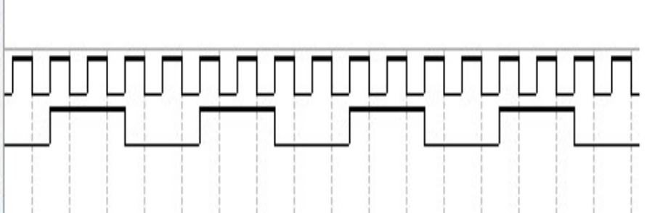

Slide 63
阻塞性赋值
当前的赋值语句阻断了其后的语句，即后面的语句必须等到当前的赋值语句执行完毕才能执行
Works a lot like software (danger!)
用于组合逻辑
module addtree(output reg [9:0] out,
input [7:0] in1, in2, in3, in4);
reg [8:0] part1, part2;
always @(in1, in2, in3, in4) begin
part1 = in1 + in2;
part2 = in3 + in4;
out = part1 + part2;
end
endmodule
in1
in2
in3
in4
+
+
part1
part2
+
out
Slide taken direct from Eric Hoffman

Slide 64
非阻塞性赋值
如果没有定时控制，则同时计算RHS和更新LHS
用于时序逻辑
只能用在"initial"和"always"中
module swap(output reg out0, out1, input rst, clk);
always @(posedge clk) begin
if (rst) begin
out0 <= 1’b0;
out1 <= 1’b1;
end
else begin
out0 <= out1;
out1 <= out0;
end
end
endmodule
D Q
rst to 0
out0
rst
clk
D Q
rst to 1
out1

Slide 65
Swapping if done in Blocking
In blocking, need a “temp” variable
module swap(output reg out0, out1, input in0, in1, swap);
reg temp;
always @(*) begin
out0 = in0;
out1 = in1;
if (swap) begin
temp = out0;
out0 = out1;
out1 = temp;
end
end
endmodule
Which values get included on the sensitivity list from *?
in0
in1
out0
swap
out1
Slide taken direct from Eric Hoffman

Slide 66
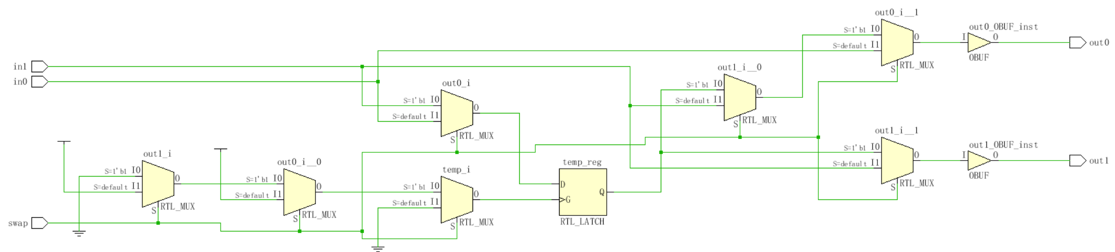
Swapping if done in Non-Blocking
module swap(output reg out0, out1, input in0, in1, swap);
reg temp;
always @(*) begin
out0 <= in0;
out1 <= in1;
if (swap) begin
temp <= out0;
out0 <= out1;
out1 <= temp;
end
end
endmodule

Slide 67
More on Blocking
Called blocking because….
  The evaluation of subsequent statements <RHS> are blocked, until the <LHS> assignment of the current statement is completed.
q1
q2
q3
module pipe(clk, d, q);
input clk,d;
output q;
reg q;
always @(posedge clk) begin
q1 = d;
q2 = q1;
q3 = q2;
end //在一个时钟沿，d传递到q3
endmodule
d
clk
Lets code this
Simulate this in your head…
Remember blocking behavior of: <LHS> assigned before
<RHS> of next evaluated.
Does this work as intended?
Slide taken direct from Eric Hoffman

Slide 68
More on Non-Blocking
Lets try that again
q1
q2
q3
d
module pipe(clk, d, q);
input clk,d;
output q;
reg q;
always @(posedge clk) begin
q1 <= d;
q2 <= q1;
q3 <= q2;
end //d传递到q3需要间隔三个时钟
endmodule;
clk
Lets code this
With non-blocking statements the <RHS> of subsequent statements are not blocked. They are all evaluated simultaneously.
The assignment to the <LHS> is then scheduled to occur.
This will work as intended.
Slide taken direct from Eric Hoffman

Slide 69
So Blocking is no good and we should always use Non-Blocking??
Consider combinational logic
module ao4(z,a,b,c,d);
input a,b,c,d;
output z;
reg z,tmp1,tmp2;
always @(a,b,c,d) begin
tmp1 <= a & b;
tmp2 <= c & d;
z <= tmp1 | tmp2;
end
endmodule
The inputs (a,b,c,d) in the sensitivity list change, and the always block is evaluated.
New assignments are scheduled for tmp1 & tmp2 variables.
A new assignment is scheduled for z using the previous tmp1 & tmp2 values.
Does this work?
Slide taken direct from Eric Hoffman

Slide 70
Why not non-Blocking for Combinational
Can we make this example work?
module ao4(z,a,b,c,d);
input a,b,c,d;
output z;
reg z,tmp1,tmp2;
always @(a,b,c,d) begin
tmp1 <= a & b;
tmp2 <= c & d;
z <= tmp1 | tmp2;
end
endmodule
module ao4(z,a,b,c,d);
input a,b,c,d;
output z;
reg z,tmp1,tmp2;
always @(a,b,c,d,tmp1,tmp2) begin
tmp1 <= a & b;
tmp2 <= c & d;
z <= tmp1 | tmp2;
end
endmodule
Yes
Put tmp1 & tmp2 in the trigger list
What is the downside of this?
Slide taken direct from Eric Hoffman

Slide 71
Verilog程序的组成部分
module Name，
port list， port declarations（if ports present）
parameters（optional），
这5个组件的排列顺序是任意的，可以选择其中的一个或几个组件构成一个Verilog程序。
Declarations of wires,
regs and other variables
Data flow statements
( assign )
Instantiation of lower level modules
Tasks and functions
Always and initial blocks,
All behavioral statements go in these blocks.
endmodule

Slide 72
任务(task)和 函数(function)
任务和函数结构之间的差异：
  一个任务块可以含有时间控制结构，而函数块则没有；
  一个任务块可以有输入和输出，而函数块必须有至少一个输入，没有任何输出；
  任务块的引发是通过一条语句，而函数块只有当它被引用在一个表达式中时才会生效。
task 任务名；
端口与类型说明；
局部变量说明；//静态的
块语句
endtask
function <位宽说明> 函数名；
输入端口与类型说明；
局部变量说明；//静态的
块语句
endfunction

Slide 73
functions
函数的定义和调用都包括在一个module内
用于实现组合逻辑
  不能包含任何时延和时序控制，不能调用任务
输入/输出
  必须有至少一个输入
  不能有输出或者双向(inout)变量
  函数的定义蕴含声明了一个与函数同名的，函数内部的寄存器，通过对该寄存器赋值来返回函数值
  可以指定返回值的宽度 (缺省1-bit)
Slide taken direct from Eric Hoffman

Slide 74
When to use functions?
Usage rules:
  May be referenced in any expression (RHS)
  May call other functions
Requirements of procedure (implemented as function)
  No timing or event control
  Returns a single value
  Has at least 1 input
  Uses only behavioral statements
  Only uses blocking assignments (combinational)
Mainly useful for conversions, calculations, and selfchecking routines that return boolean. (testbenches)
Slide taken direct from Eric Hoffman

Slide 75
Function Example [1]
module word_aligner (word_out, word_in);
output [7: 0] word_out;
input [7: 0] word_in;
assign word_out = aligned_word(word_in); // invoke function
function [7: 0] aligned_word; // function declaration
input [7: 0] word;
begin
aligned_word = word;
if (aligned_word != 0)
while (aligned_word[7] == 0) aligned_word = aligned_word << 1;
end
endfunction
endmodule
size of return value
input to function
Does this synthsize?
Slide taken direct from Eric Hoffman

Slide 76
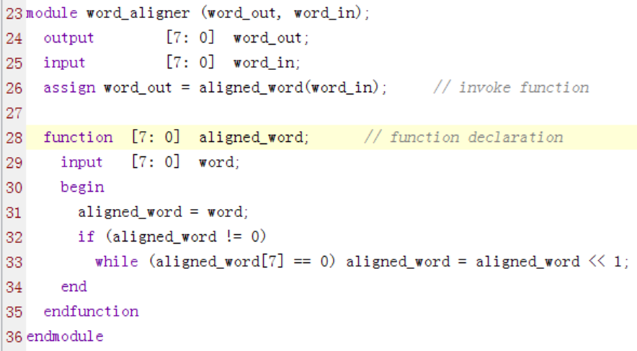
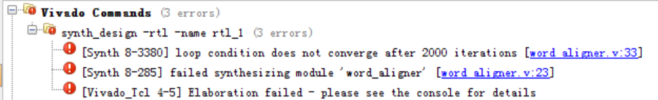
Function Example

Slide 77
Function Example [2]
module arithmetic_unit (result_1, result_2, operand_1, operand_2,);
output [4: 0] result_1;
output [3: 0] result_2;
input [3: 0] operand_1, operand_2;
assign result_1 = sum_of_operands (operand_1, operand_2);
assign result_2 = larger_operand (operand_1, operand_2);
function [4: 0] sum_of_operands(input [3:0] operand_1, operand_2);
sum_of_operands = operand_1 + operand_2;
endfunction
function [3: 0] larger_operand(input [3:0] operand_1, operand_2);
larger_operand = (operand_1 >= operand_2) ? operand_1 : operand_2;
endfunction
endmodule
function call
function inputs
function output
Slide taken direct from Eric Hoffman

Slide 78
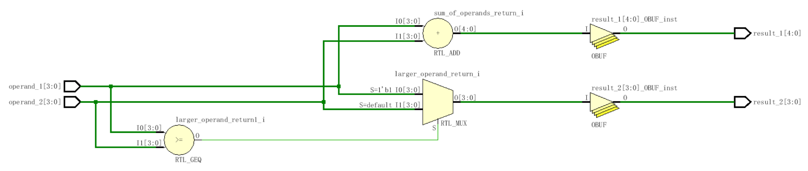
Function Example [2]

Slide 79
Re-Entrant (recursive) functions
Use keyword automatic to enable stack saving of function working space and enable recursive functions.
module top;
//Define the factorial function
function automatic integer factorial;
input [31:0] oper;
begin
if (oper>=2)
factorial = factorial(oper-1)*oper;
else
factorial = 1;
end
endfunction
initial begin
result = factorial(4);
$display(“Result is %d”,result);
end
endmodule
Is this how you would do it?
KISS
Slide taken direct from Eric Hoffman

Slide 80
tasks (much more useful than functions)
Functions | Tasks
函数只能调用其他函数，不能调用任务 | 任务可以调用其他任务和函数
函数总是在仿真时刻0开始 | 任务可以在非零时刻开始执行
函数一定不能包含任何延迟，事件或者时序控制声明语句 | 任务可以包含延迟，事件或者时序控制声明语句 (i.e. ➔ @, #)
函数至少要有一个输入参数，也可以有多个输入变量 | 任务可以没有或者有多个输入，输出，双向参数
函数只能返回一个值，不能有输出或者双向变量 | 任务不返回任何值，但是返回多个输出或双向变量值
Tasks can modify global signals too, perhaps naughty, but I do it all the time.
Slide taken direct from Eric Hoffman

Slide 81
Why use Tasks?
Tasks provide the ability to
  Execute common procedures from multiple places
  Divide large procedures into smaller ones
Local variables can be declared & used
Personally, I only use tasks in testbenches, but they are very handy there.
  Break common testing routines into tasks
    Initialization tasks
    Stimulus generation tasks
    Self Checking tasks
  Top level test then becomes mainly calls to tasks.
Slide taken direct from Eric Hoffman

Slide 82
Task Example [Part 1]
任务调用:
（1）任务调用语句是过程性语句，只能出现在过程块内；
（2）任务调用语句中的信号
端口顺序和类型必须和任务定义结构中的顺序和类型一致。
（3）任务的输出端口必须是寄存器类型。
module adder_task (c_out, sum, clk, reset, c_in, data_a, data_b);
output reg [3: 0] sum;
output reg c_out;
input [3: 0] data_a, data_b;
input clk, reset, c_in;
always @(posedge clk or posedge reset) begin
if (reset) {c_out, sum} <= 0;
else add_values (sum, c_out, data_a, data_b, c_in); // invoke task
end
// Continued on next slide
Slide taken direct from Eric Hoffman

Slide 83
Task Example [Part 2]
任务定义:
（1）任务端口不受限制
（2）在任务中可以调用其他的任务或函数。
（3）任务定义内不能出现 initial和 always过程块。
// Continued from previous slide
task add_values; // task declaration
output reg [3: 0] SUM;
output reg C_OUT;
input [3: 0] DATA_A, DATA_B;
input C_IN;
{C_OUT, SUM} = DATA_A + (DATA_B + C_IN);
endtask
endmodule
Could have instead specified inputs/outputs using a port list.
task add_values (output reg [3: 0] SUM, output reg C_OUT,
input [3:0] DATA_A, DATA_B, input C_IN);
task outputs
task inputs
Slide taken direct from Eric Hoffman

Slide 84
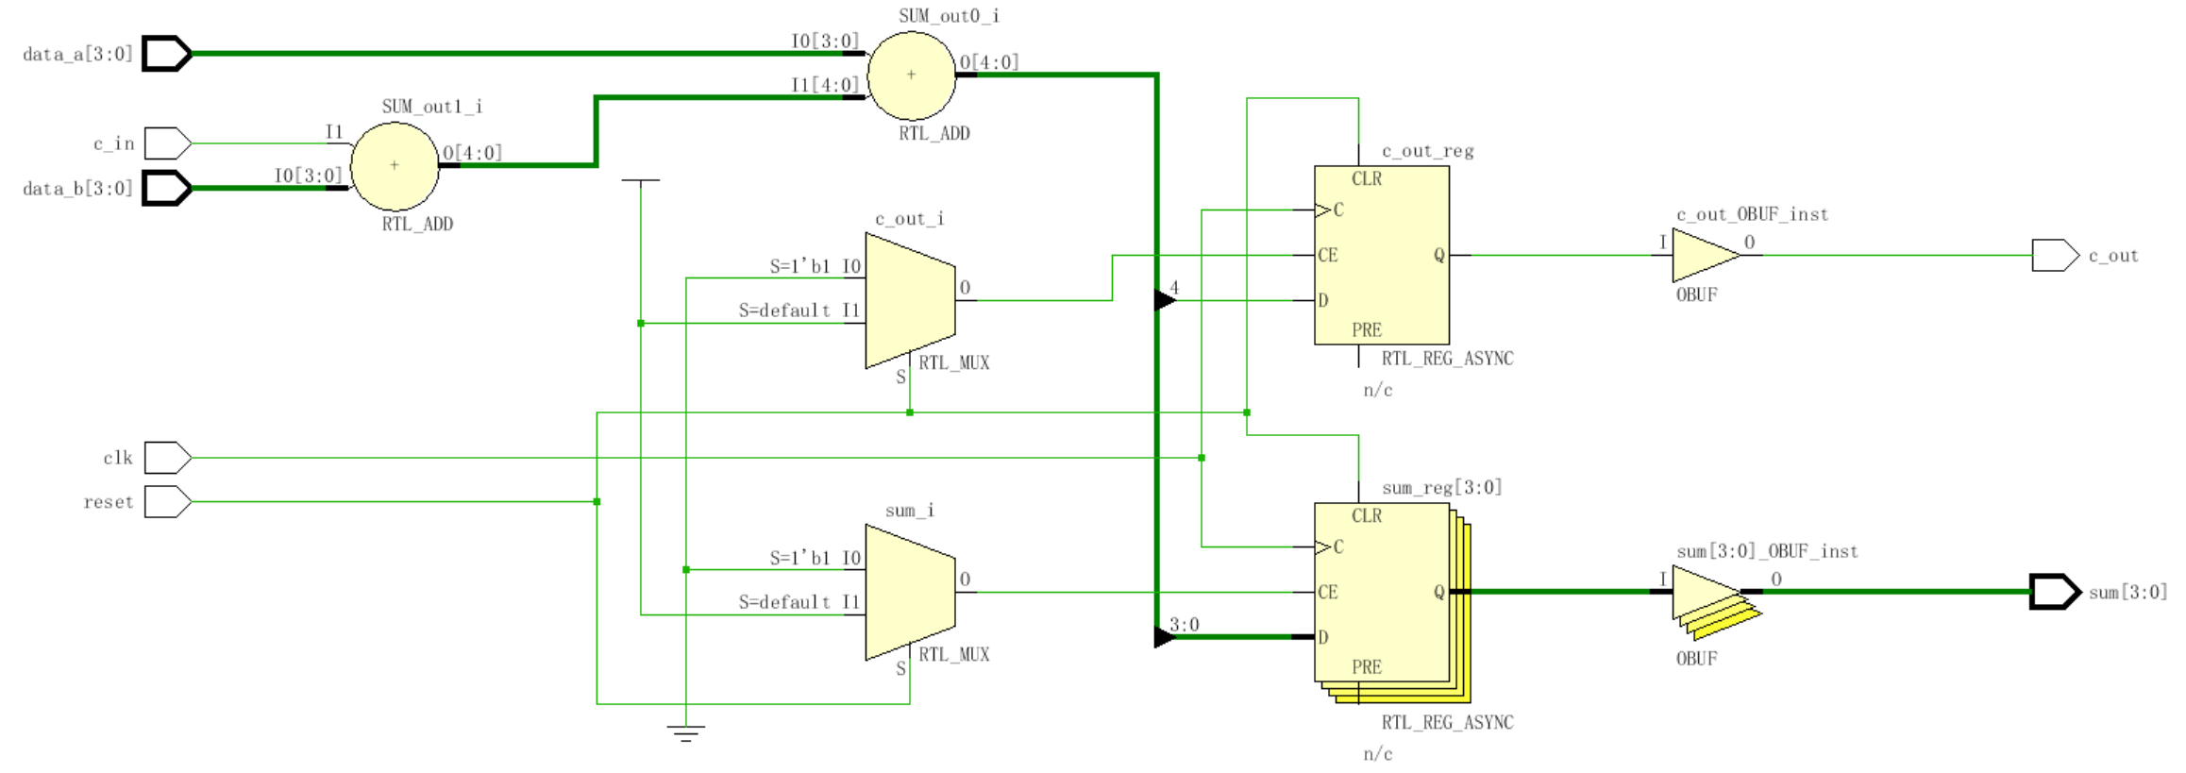
Task Example [Part 3]

Slide 85
Task Example [2]
task leading_1(output reg [2:0] position, input [7:0] data_word);
reg [7:0] temp;
  begin
  temp = data_word;
  position = 7;
  while (!temp[7]) begin
  temp = temp << 1;
  position = position - 1;
  end
  end
endtask
internal task variable
NOTE:
“while” loops usually
not synthesizable!
What does this task assume for it to work correctly?
How do tasks differ from modules?
How do tasks differ from functions?
Slide taken direct from Eric Hoffman

Slide 86
时序控制
  由“#”符号引入的延迟控制。它将程序的执行过程中断一定的时间，时间的长度由<time>的值来确定。
  由“@”符号引入的事件控制。一个事件可以通过运行表达式“-> event”变量被激发。
  等待语句。直到表达式计算为真之前，都延时下一个语句的执行。
  延迟定义块。对模块中某一指定
  的路径进行延迟定义，这一路径
  连接模块的输入端口与输出端口
  （或双向端口）。
＃ <time> <statement> ；
@ (<posedge>|<negedge>|<signals> ) <statement>；
wait (<expression>) <statement> ；
specify
(<expression>) = <time>
……
endspecify
(a=>out)=9;

Slide 87
命名块
Blocks (begin/end) or (fork/join) can be named
  命名块中可以声明局部变量；
  命名块中声明的变量可以通过层次名引用进行访问；
  命名块可以被禁用（例如停止其执行）
module top();
initial begin: block1 //名字为block1的过程命名块
integer i; // i 是block1命名块的静态局部变量
//可以用层次名top.block1.i 被其他模块访问
…
end // end of block1
endmodule
block name

Slide 88
disable Statement
Similar to the “break” statement in C
  Disables execution of the current block (not permanently)
block name
block name
begin : break
for (i = 0; i < n; i = i+1) begin : continue
@(posedge clk)
if (a == 0) // "continue" loop
disable continue;
if (a == b) // "break" from loop
disable break;
statement1
statement2
end
end
What occurs if (a==0)?
What occurs if (a==b)?
How do they differ?

Slide 89
File I/O – Why?
If we don’t want to hard-code all information in the testbench, we can use input files
Help automate testing
  One file with inputs
  One file with expected outputs
Can have a software program generate data
  Create the inputs for testing
  Create “correct” output values for testing
  Can use files to “connect” hardware/software system

Slide 90
Opening/Closing Files
$fopen opens a file and returns an integer descriptor
  integer fd = $fopen(“filename”);
  integer fd = $fopen(“filename”, r);
  If file cannot be open, returns a 0
  Can output to more than one file simultaneously by writing to the OR ( | ) of the relevant file descriptors
    Easier to have “summary” and “detailed” results
$fclose closes the file
$fclose(fd);

Slide 91
Writing To Files
Output statements have file equivalents
  $fmonitor()
  $fdisplay()
  $fstrobe()
  $fwrite() // write is like a display without the \n
These system calls take the file descriptor as the first argument
  $fdisplay(fd, “out=%b in=%b”, out, in);

Slide 92
Reading From Files
Read a binary file: $fread(destination, fd);
  Can specify start address & number of locations too
  Good luck! I have never used this.
Very rich file manipulation (see IEEE Standard)
  $fseek(), $fflush(), $ftell(), $rewind(), …
Will cover a few of the more common read commands next

Slide 93
Using $fgetc to read characters
module file_read()
parameter EOF = -1;
integer file_handle,error,indx;
reg signed [15:0] wide_char;
reg [7:0] mem[0:255];
reg [639:0] err_str;
initial begin
indx=0;
file_handle = $fopen(“text.txt”,”r”);
error = $ferror(file_handle,err_str);
if (error==0) begin
wide_char = 16’h0000;
while (wide_char!=EOF) begin
wide_char = $fgetc(file_handle);
mem[indx] = wide_char[7:0];
$write(“%c”,mem[indx]);
indx = indx + 1;
end
end
else $display(“Can’t open file…”);
$fclose(file_handle);
end
endmodule
The quick brown fox jumped over the lazy dogs
text.txt
When finished the array mem will contain the characters of this file one by one, and the file will have been echoed to the screen.
Why wide_char[15:0] and why signed?

Slide 94
Using $fgets to read lines
module file_read2()
integer file_handle,error,indx,num_bytes_in_line;
reg [256*8:1] mem[0:255],line_buffer;
reg [639:0] err_str;
initial begin
indx=0;
file_handle = $fopen(“text2.txt”,”r”);
error = $ferror(file_handle,err_str);
if (error==0) begin
num_bytes_in_line = $fgets(line_buffer,file_handle);
while (num_bytes_in_line>0) begin
mem[indx] = line_buffer;
$write(“%s”,mem[indx]);
indx = indx + 1;
num_bytes_in_line = $fgets(line_buffer,file_handle);
end
end
else $display(“Could not open file text2.txt”);
$fgets() returns the number of bytes in the line. When this is a
zero you know you hit EOF.

Slide 95
Using $fscanf to read files
module file_read3()
integer file_handle,error,indx,num_matches;
reg [15:0] mem[0:255][1:0];
reg [639:0] err_str;
initial begin
indx=0;
file_handle = $fopen(“text3.txt”,”r”);
error = $ferror(file_handle,err_str);
if (error==0) begin
num_matches = $fscanf(file_handle,”%h %h”,mem[indx][0],mem[indx][1]);
while (num_matches>0) begin
$display(“data is: %h %h”,mem[indx][0],mem[indx[1]);
indx = indx + 1;
num_matches = $fscanf(file_handle,”%h %h”,mem[indx][0],mem[indx][1]);
end
end
else $display(“Could not open file text3.txt”);
12f3 13f3
abcd 1234
3214 21ab
text3.txt

Slide 96
Loading Memory Data From Files
This is very useful (memory modeling & testbenches)
  $readmemb(“<file_name>”,<memory>);
  $readmemb(“<file_name>”,<memory>,<start_addr>,<finish_addr>);
  $readmemh(“<file_name>”,<memory>);
  $readmemh(“<file_name>”,<memory>,<start_addr>,<finish_addr>);
$readmemh ➔ Hex data…$readmemb ➔ binary data
  But they are reading ASCII files either way (just how numbers are represented)
// addr data
@0000 10100010
@0001 10111001
@0002 00100011
// addr data
@0000 A2
@0001 B9
@0002 23
//data
A2
B9
23
example “binary”
file
example “hex”
file
address is optional for the lazy

Slide 97
Example of $readmemh
module rom(input clk; input [7:0] addr; output [15:0] dout);
reg [15:0] mem[0:255]; // 16-bit wide 256 entry ROM
reg [15:0] dout;
initial
$readmemh(“constants”,mem);
always @(negedge clk) begin
///////////////////////////////////////////////////////////
// ROM presents data on clock low //
/////////////////////////////////////////////////////////
dout <= mem[addr];
end
endmodule

Slide 98
‘Include Compiler Directives
`include filename
  Inserts entire contents of another file at compilation
  Can be placed anywhere in Verilog source
  Can provide either relative or absolute path names
Example 1:
    module use_adder8(…);
    `include “adder8.v” // include the task for adder8
Example 2:
    module cppc_dig_tb();
    `include “/home/ehoffman/ece551/project/tb_tasks.v”
Useful for including tasks and functions in multiple modules

